Slide 1
Iowa Liquor Sales Analysis
Thomas Han

Slide 2

The Problem
How should you allocate Iowa’s liquor stores’ marketing budget to increase their profit and sales for upcoming campaign?
Sales trend
Popular/Unpopular liquors
Margin profit

Slide 3
Summary Findings
Stores Table
99 Iowa counties with 1973 stores.
Products Table
69 total of product categories
271 unique vendors listed
Sales Table
Canadian whiskies($48,053,061.91) sells the best
High proof beer($4,027.28) sells the least
Counties Table
Polk selling the most of $86,397,461.79
Linn is the second most sold counties with $34,460,047.49. About $51,937,414 difference from Polk county
Fremont county being the least selling county with $16,603.67

Slide 4
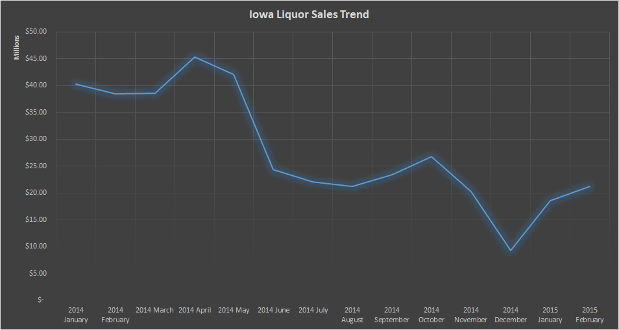
Trend is decreasing starting from May

Slide 5
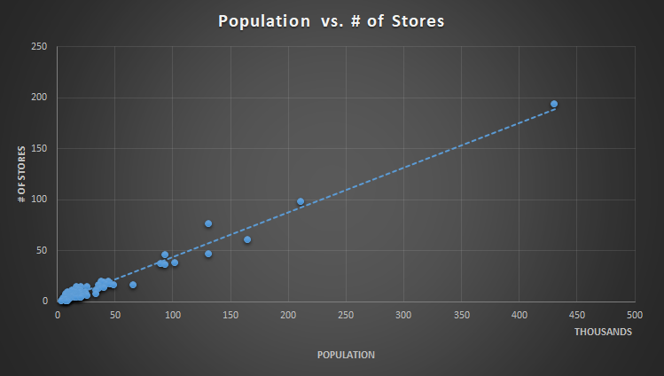
Positive correlation
Doesn’t necessarily need to extend more stores in each counties

Slide 6
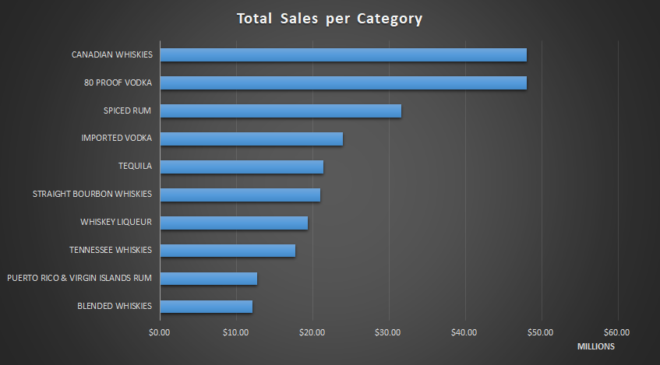
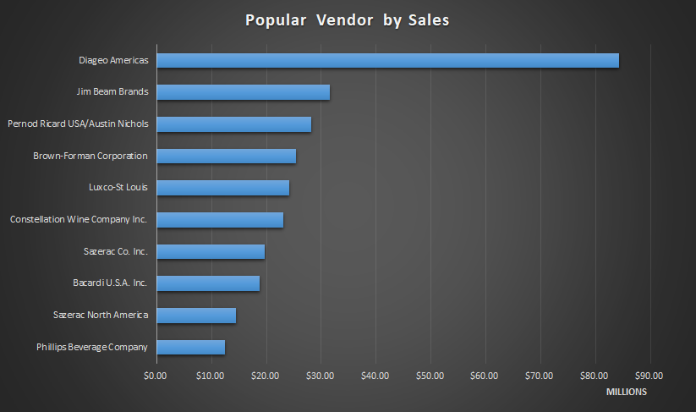
Best Sellers
Top categories: Canadian whiskies, 80 proof vodka, spiced rum, tequila, imported vodka
Top vendors: Diageo Americas, Jim Beam Brands, Pernod Ricard USA

Slide 7
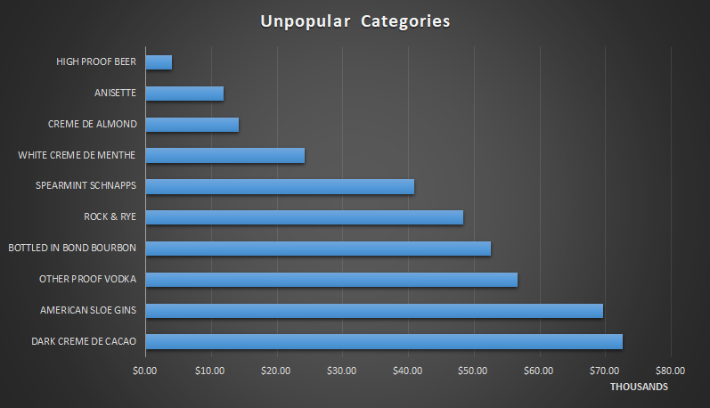
Least Selling Categories
Discount/clearance to clear most of the inventory
Least sellings: High proof beer, anisette, and creme de almond

Slide 8
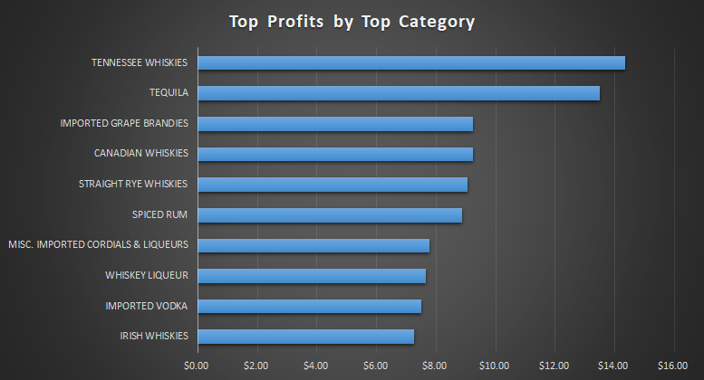
Margin Profit
Chose the top 10 categories that sells the most
Highest profit: Tennessee whiskey and tequila

Slide 9
Recommendation
No need to increase the amount of stores in each counties
Sell unpopular liquors based on unpopular brands or category with discounts or clearance sales
To clean the inventory and once cleaned, can stock with popular brands or category
High proof beer, anisette, creme de almond, and etc.
Focus on the top liquor categories/brands that make the most profit and that are popular
Whiskies, Vodka, Tequila, and Rum
Brand: Diageo Americas, Jim Beam Brands, Pernod Ricard USA
Promote more during the holiday seasons

